Slide 1
Project 3 - Group 4: Data Engineering Path
Pushpa Chhetri, Amy Johnson, Megan Neal, Trenton Paxton
Notes:
This project explores music data using the Deezer API. The goal was to create a structured pipeline for extracting, transforming, and storing data in a relational database. By analyzing the data, we provide insights into artists, tracks, and albums. Our shared interest in music inspired this project, and Deezer's accessible API provided the foundation for our analysis.

Slide 2
Overview
5 favorite artists each Select a music streaming service Extract: Retrieved artist and track data via the Deezer API.
Transform: Cleaned and formatted data to fit database schema.
Load: Stored data into two tables: artists and tracks_data.
Documentation: Created ETL, ERD, and workflow diagrams.
Read data from the database and display it for future use, using either Pandas DataFrame or Flask API with JSON output
Notes:
The primary objective of this project was to design an ETL pipeline to process music data from Deezer. After extracting data, we transformed it for consistency and stored it in a relational database. This process allowed us to generate valuable insights, including fan metrics, artist popularity, and album rankings.

Slide 3


Extraction API: Spotify vs. Deezer
We used the Deezer API to extract music data, focusing on its diverse and accessible catalog.
Spotify
Deezer
Accessibility: API requires user authentication for most features, with a limited one-hour token lifespan.
API Features: Highly robust but constrained by account-based usage (user must have a Spotify account).
Usage Terms: Tied to personal accounts or paid subscriptions, limiting non-commercial academic use.
Popularity: Dominates the global market with the largest user base among streaming platforms.
Data Depth: Extensive library with metadata, but stricter access rules compared to Deezer.
Streaming Niche: Known as the leading streaming giant, often favored for personal listening over development use.
Accessibility: API is accessible without requiring user authentication for most basic features.
API Features: Provides data on artists, albums, tracks, and playlists with straightforward documentation.
Usage Terms: Allows academic use without requiring a paid account or ongoing authentication keys.
Popularity: Global availability in over 180 countries but smaller user base compared to Spotify.
Data Depth: Offers extensive metadata on tracks, including duration, rank, and associated artists/albums.
Streaming Niche: Lesser-known platform compared to Spotify, often regarded as more "open" for development use.
Ethical Considerations
After our experience with the Spotify API, we did research on the Terms of Service for both APIs. Deezer has very clear guidelines that restrict their data being used for any commercial purposes unless a contract has been established.
Notes:
We initially considered using the Spotify API due to its dominance in the streaming market and extensive library. However, we encountered several challenges that led us to pivot to the Deezer API. Spotify’s API requires user authentication tied to personal accounts, with keys that expire after one hour. Additionally, certain features are locked behind paid subscriptions, which raised ethical concerns for academic use.
Deezer proved to be a more practical and accessible alternative. Its API provides a robust global music catalog without requiring accounts or subscriptions, and its terms of use explicitly allow academic projects. Deezer’s documentation is straightforward, enabling efficient extraction and analysis of artist and track data. With availability in over 180 countries, Deezer ensures a diverse and comprehensive dataset, making it an ideal choice for our project’s needs.
This comparison highlights the technical and ethical advantages of Deezer for our ETL workflows and aligns with our project’s goal of analyzing global music data efficiently and responsibly.

Slide 4
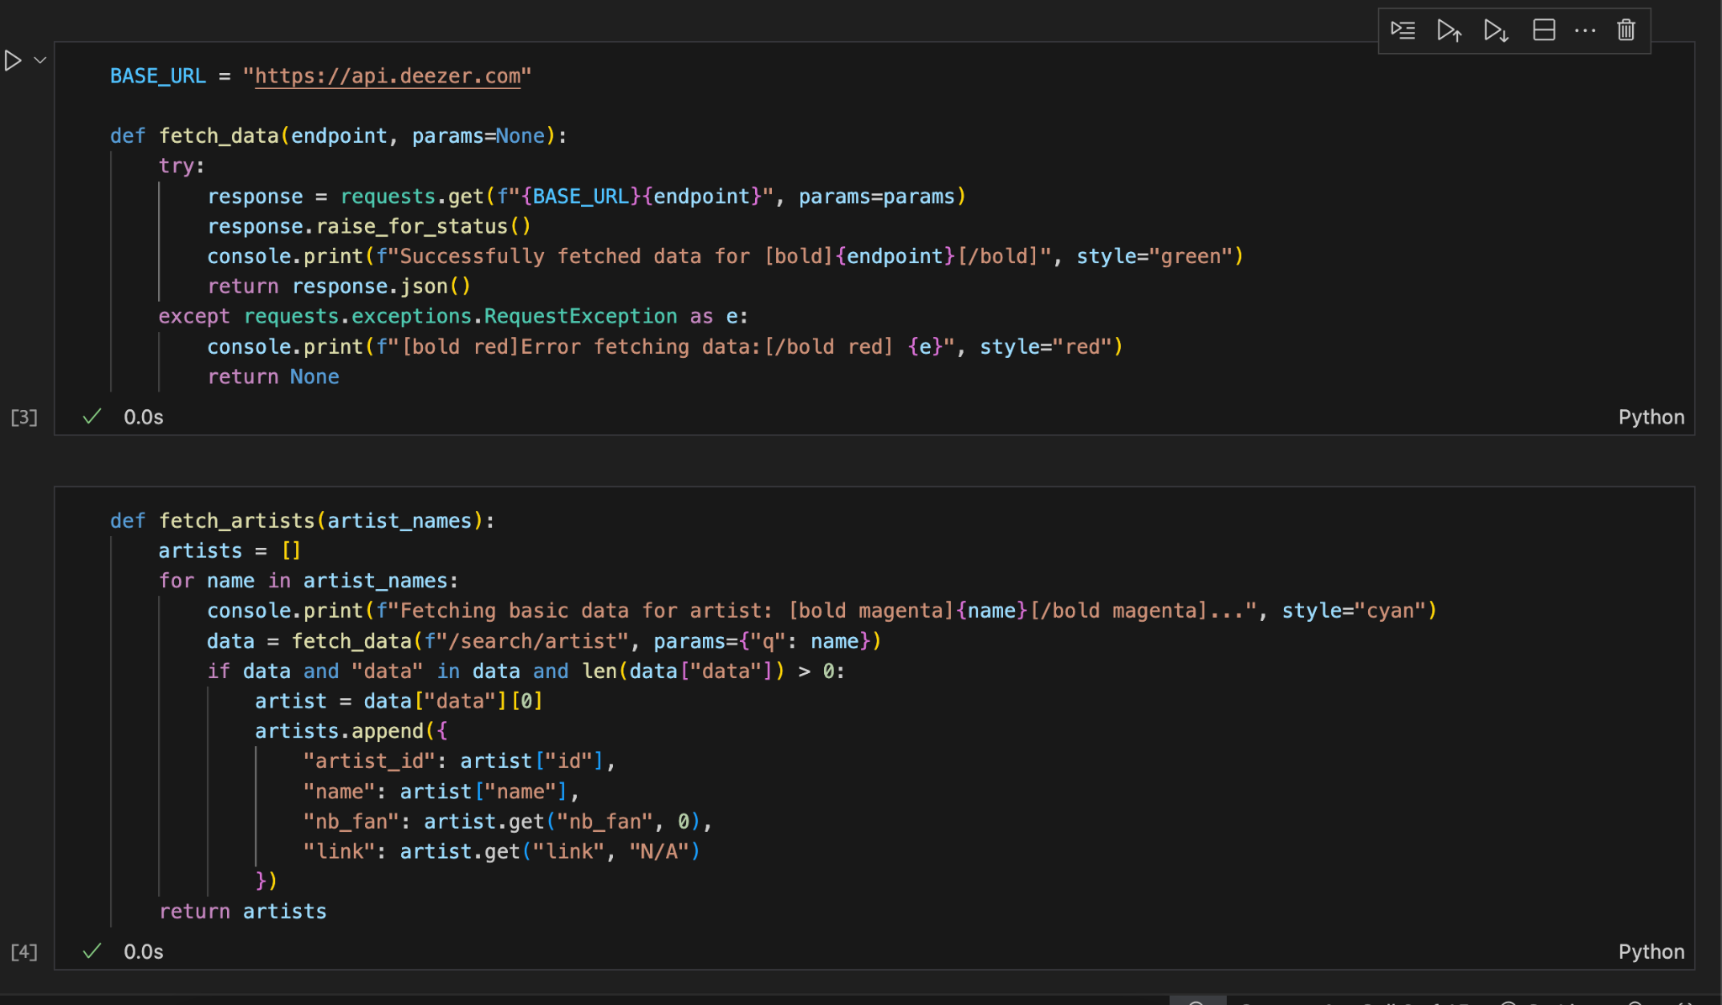
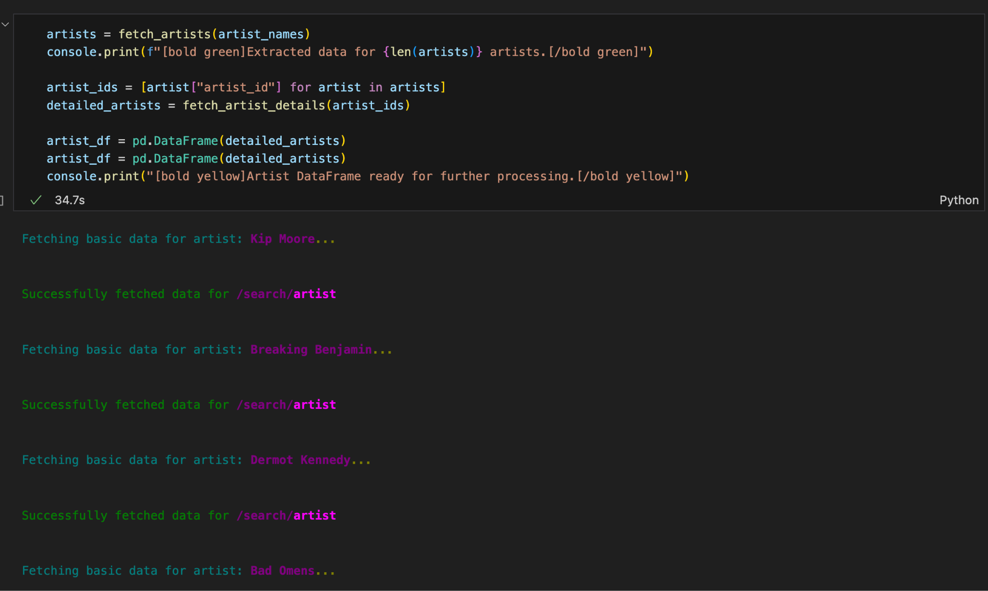
Extraction > Transform > Load:
Data extracted via API, transformed to match schema requirements, loaded into a relational database with two tables: artists and tracks_data.
Extraction from Deezer API
Output using Rich Library
Notes:
The ETL process involved extracting data from Deezer’s API, transforming it to ensure compatibility with our schema, and loading it into a relational database. This allowed us to create a clean, structured dataset ready for analysis.

Slide 5
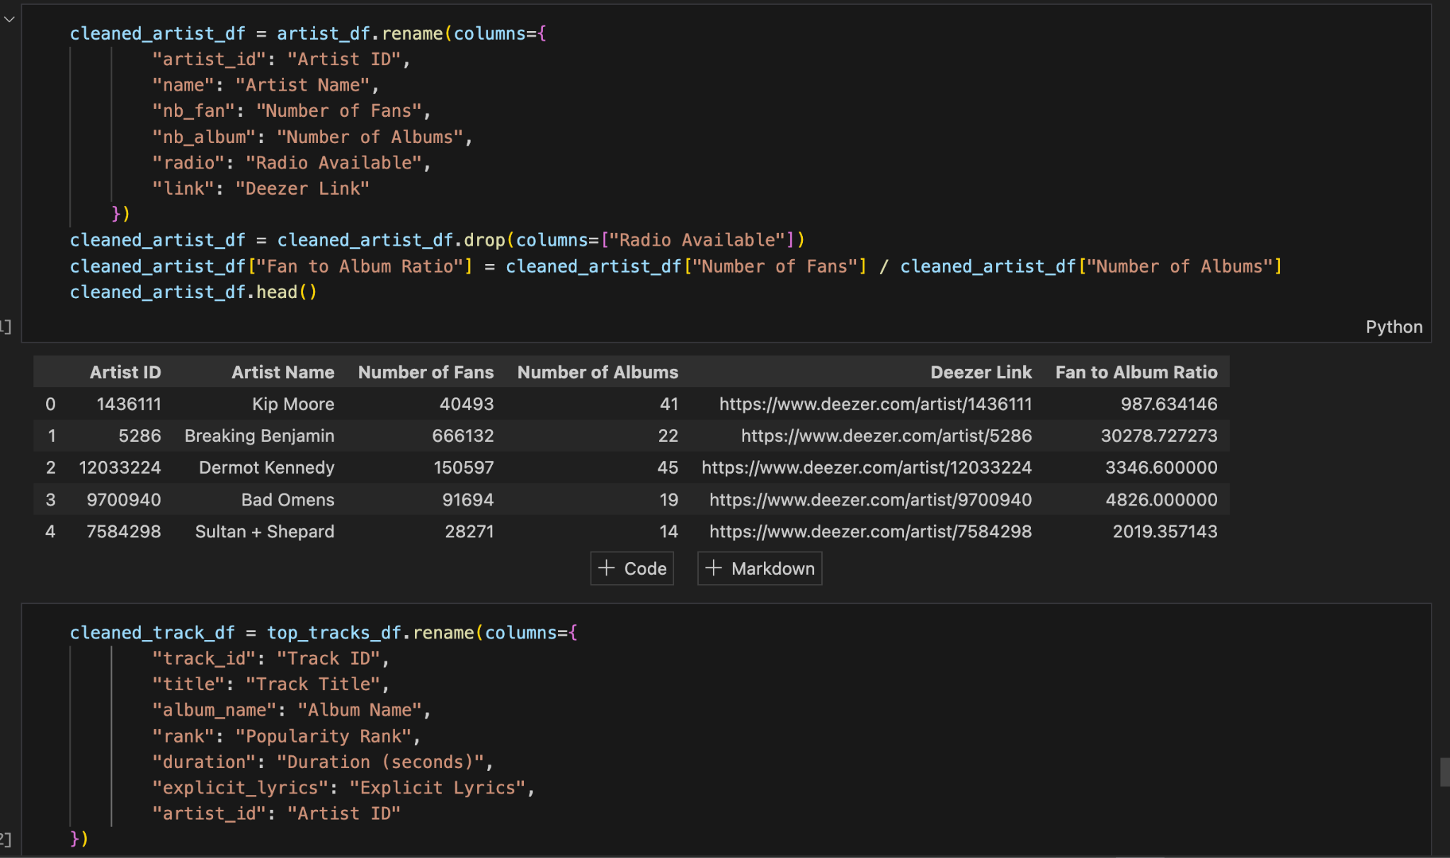
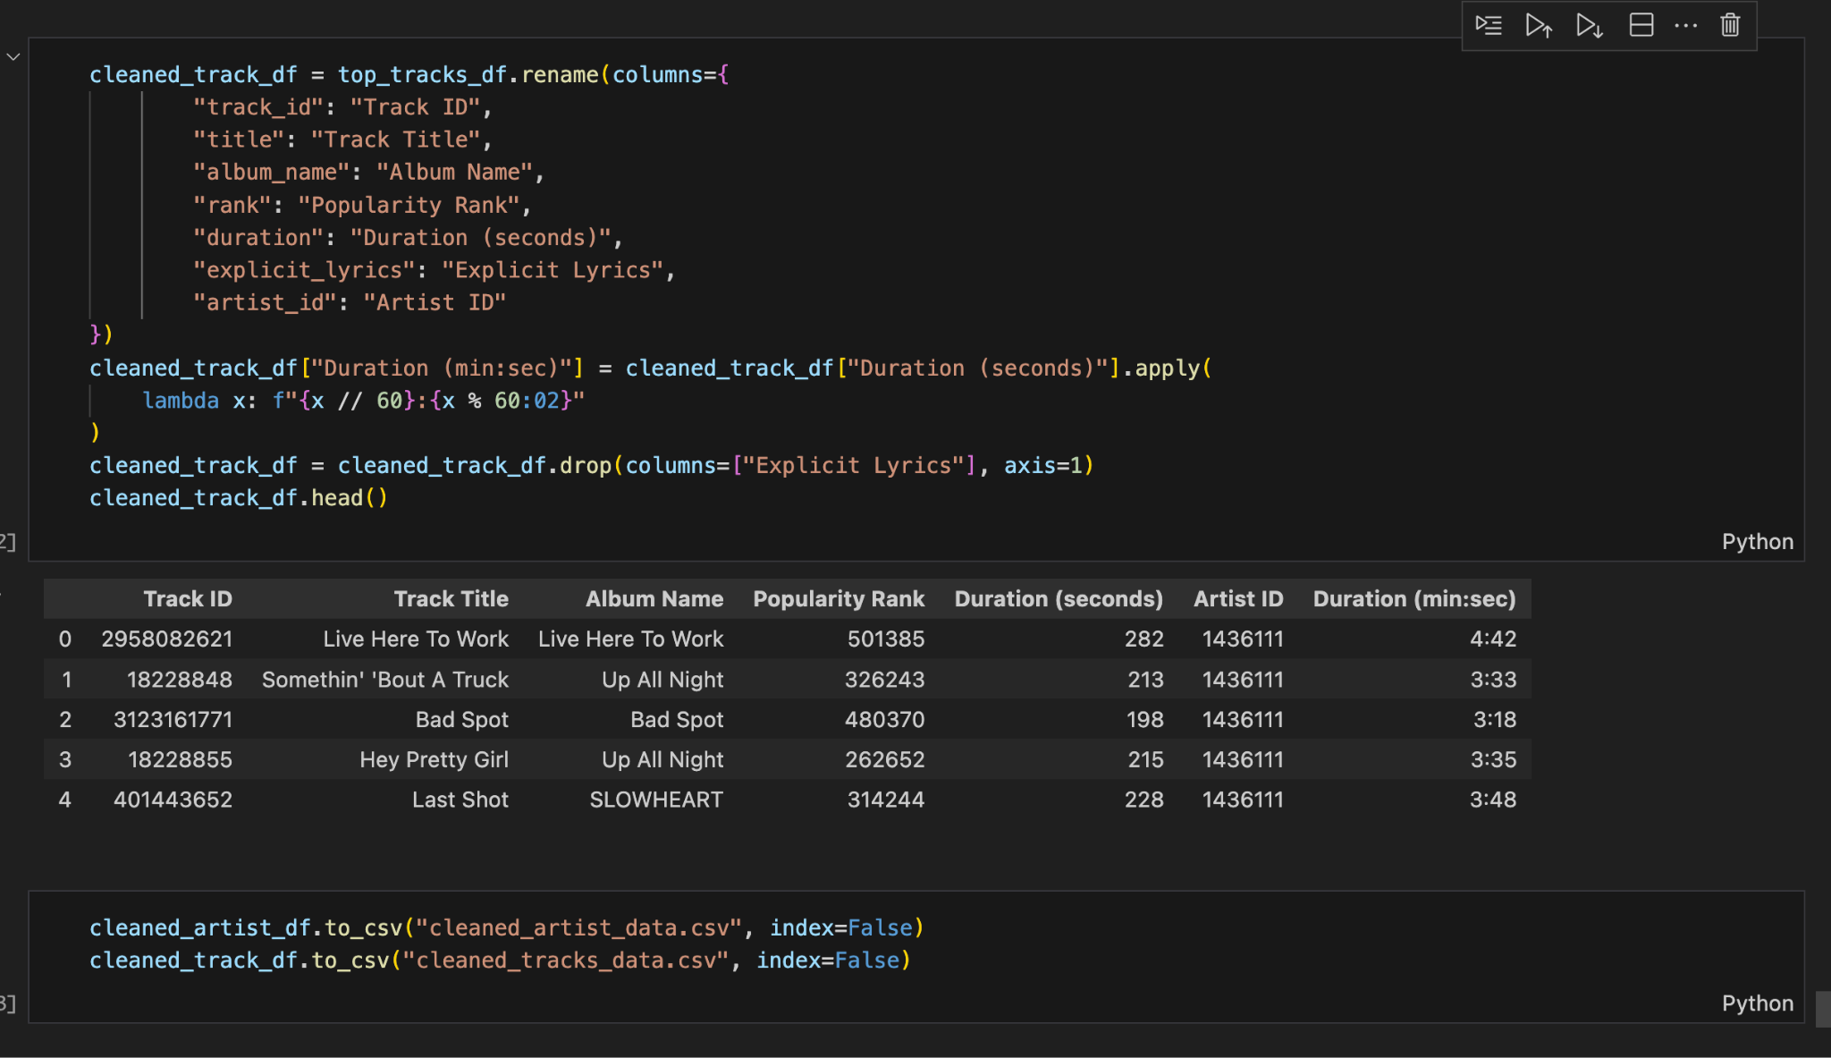
Extraction > Transform > Load:
Data extracted via API, transformed to match schema requirements, loaded into a relational database with two tables: artists and tracks_data.
Data stored in a Dataframe
Data is Transformed and Prepped for Loading
Notes:
The ETL process involved extracting data from Deezer’s API, transforming it to ensure compatibility with our schema, and loading it into a relational database. This allowed us to create a clean, structured dataset ready for analysis.

Slide 6
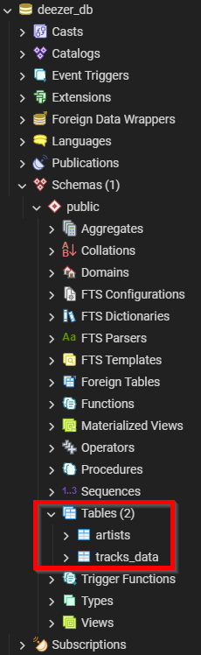
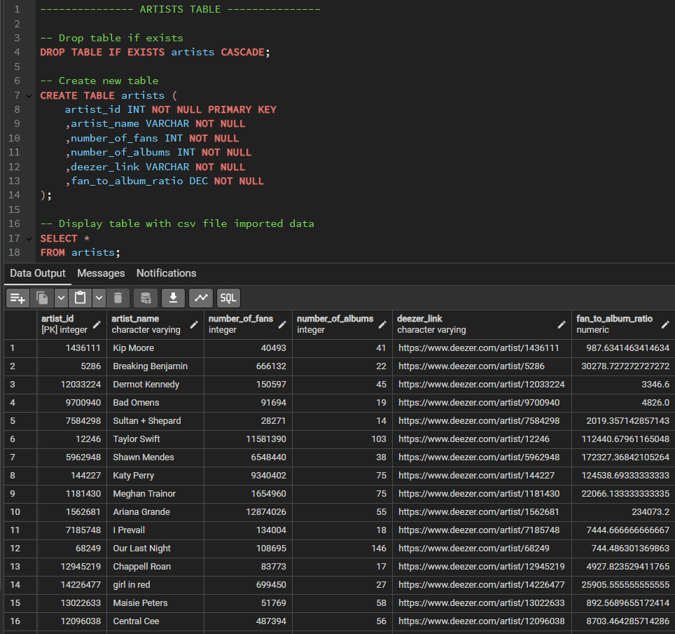
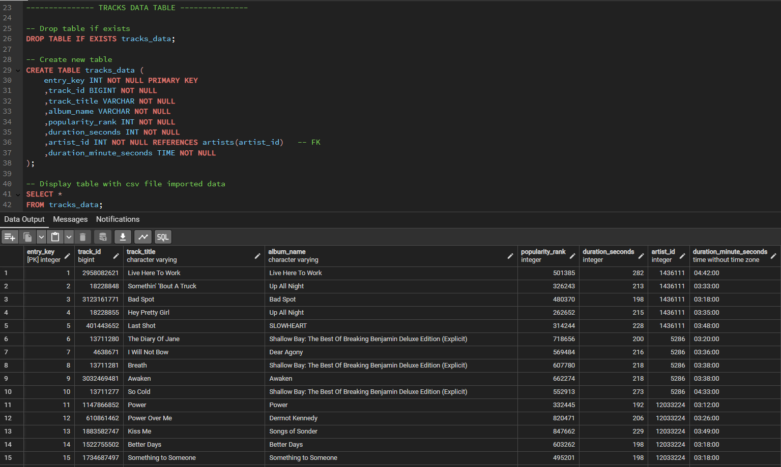
Storing Data in a Database
Created table schema and imported csv files for artists and tracks_data from the deezer_api_etl Python code
Notes:
The database schema was designed to store artists and tracks_data in a relational format. The ERD illustrates how the tables are connected through primary and foreign key relationships, enabling queries that link artists to their tracks. The relational design not only organizes the data but also unlocks the potential for uncovering patterns in how artists’ popularity correlates with their discography and fan base—a critical step toward meaningful music analytics.

Slide 7
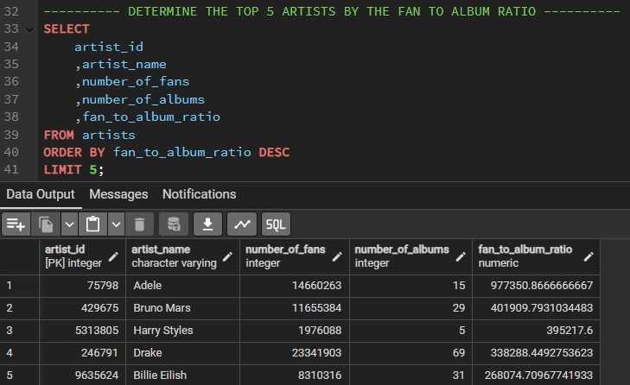
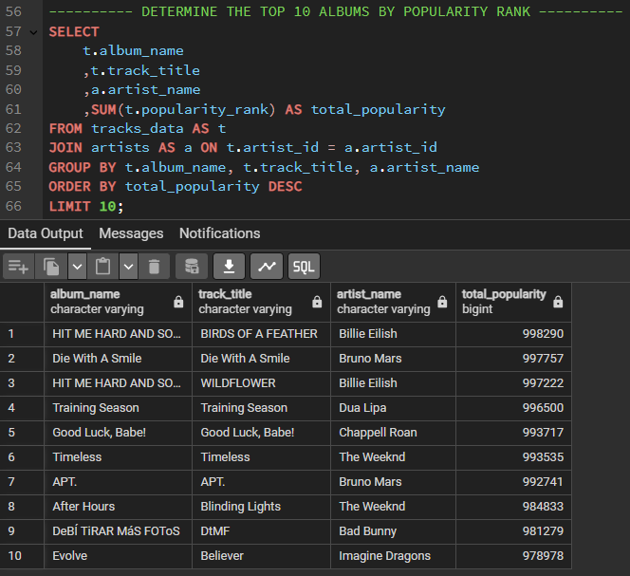
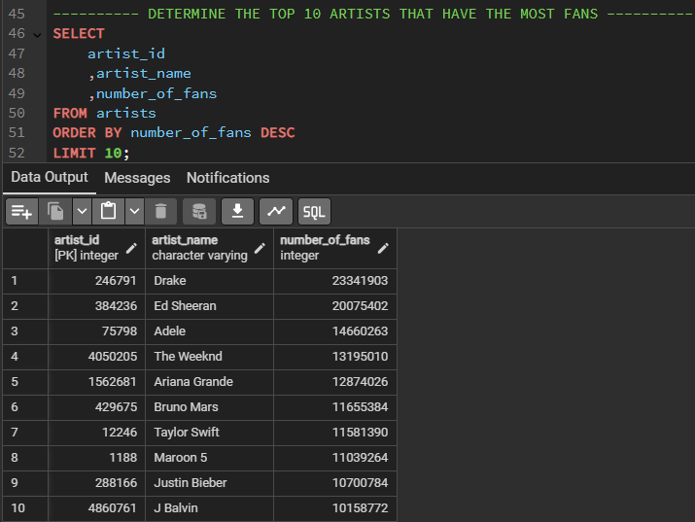
SQL Queries
Joined the tables together and built queries with different aggregations for data analysis
Notes:
By joining tables and using aggregations, we can answer key questions like identifying top artists by fan-to-album ratio, ranking albums by popularity, and analyzing track counts. This approach transforms raw data into actionable metrics that inform deeper understanding.

Slide 8

ERD
The Entity Relationship Diagram (ERD) between artists and tracks is illustrating a one-to-many relationship, where each artist can have multiple tracks associated with them. In this diagram, the "Artists" entity would include attributes such as artist_id (primary key), while the "Tracks_Data" entity would include attributes like entry_key(primary key), artist_id (foreign key).
Tracks_Data
Artists
entry_key track_id track_title album_name popularity_rank duration_seconds artist_id duration_minute_seconds
int bigint varchar varchar int int int time
artist_id artist_name number_of_fans number_of_albums deezer_link fan_to_album_ratio
int varchar int int varchar dec

Slide 9
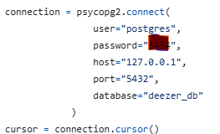
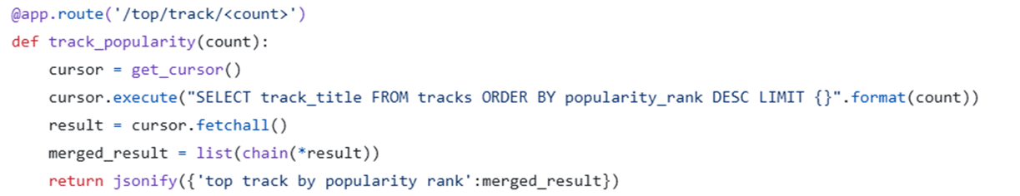
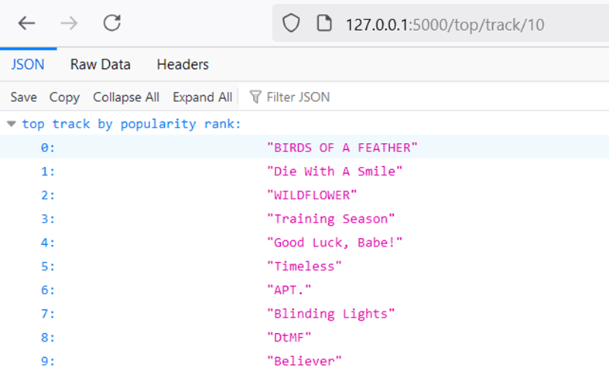
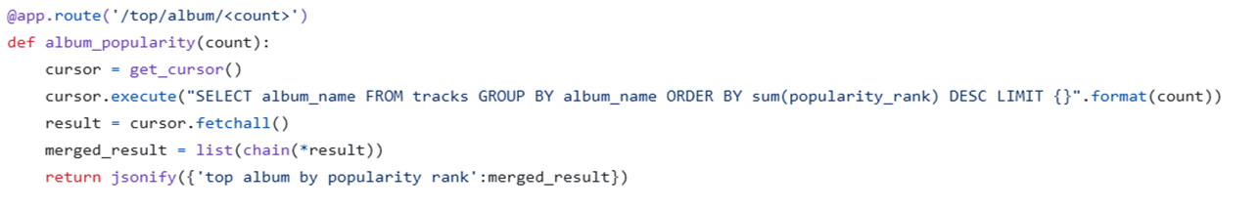
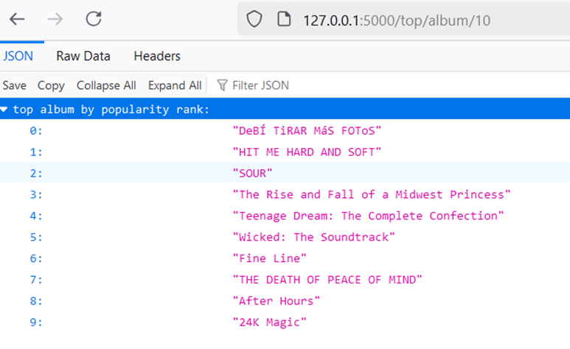
Flask API
Make postgres connection using Psycopg2 library

Slide 10
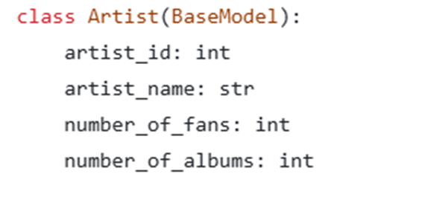
Additional Data Engineering Libraries
Rich:
Rich is a Python library that enhances console output with text and formatting options such as colors, tables, and progress brars. It simplifies the creation of visually appealing command lines.
Pydantic:
It is a data validation and settings management library for Python that uses Python type annotations to validate and serialize data. It is commonly used in scenarios where you need to ensure that the data conforms to certain types and constraints, such as when working with APIs, configuration files, or data models.
Defining Artist a class extending BaseModel to validate that each field has a dedicated data type.

Slide 11
Exploring Insights from the Data
Examples of questions the data can answer:
Which artist has the most tracks in the database?
Who are the top 5 artists with the best fan-to-album ratio?
Which albums are ranked highest in popularity?
Which tracks are ranked highest in popularity?
Who are top 10 artists that have the most fans?
How many tracks are associated with each artist?
Notes:
This slide highlights questions our data can answer, offering insights into artist performance, fan engagement, and track popularity. By utilizing the structured data, we can explore artist-specific metrics, album rankings, and track-related trends, providing a foundation for deeper musical analysis.

Slide 12


